Slide 1
CSL2060 Project
Group 44

Slide 2
About the Topic
Topic: An app to detect the chances of a cardiovascular disease in humans
We have designed an app that takes the health parameters of the user as input, and then predicts the chance of a cardiovascular disease occurring.
An ML model has been trained using existing datasets on the same topic, and based on it, risk assessment has been done.
The app also includes a few additional features, which are mentioned in the subsequent sections.
The workflow, and other additional features, can best be visualized through these 5 UML Diagrams.

Slide 3
Software Requirements Specification Document
We have made 4 versions of SRS document through the course of this project.
Changes made from draft 3 to draft 4:
Modification in the overall architecture style: User’s information shall be stored locally and not on the central server to enhance security. This implies the usage of serverless architecture for this purpose, while the rest of the application proceeds with client-server architecture, as had been discussed earlier. This change is reflected in point (2.1.3).
Addition of the option to update profile information, as is reflected in the application (2.2.2)
Utilization of Flask for ML model is now reflected (2.4.4).
Usage of SQLite database is now mentioned (2.7.2).
Addition of scalability as a non-functional requirement (3.2).
Addition of security as a non-functional requirement (3.4).
Updates in the legal considerations as the application will be directly related to the health of personnels (4.1.2).

Slide 4
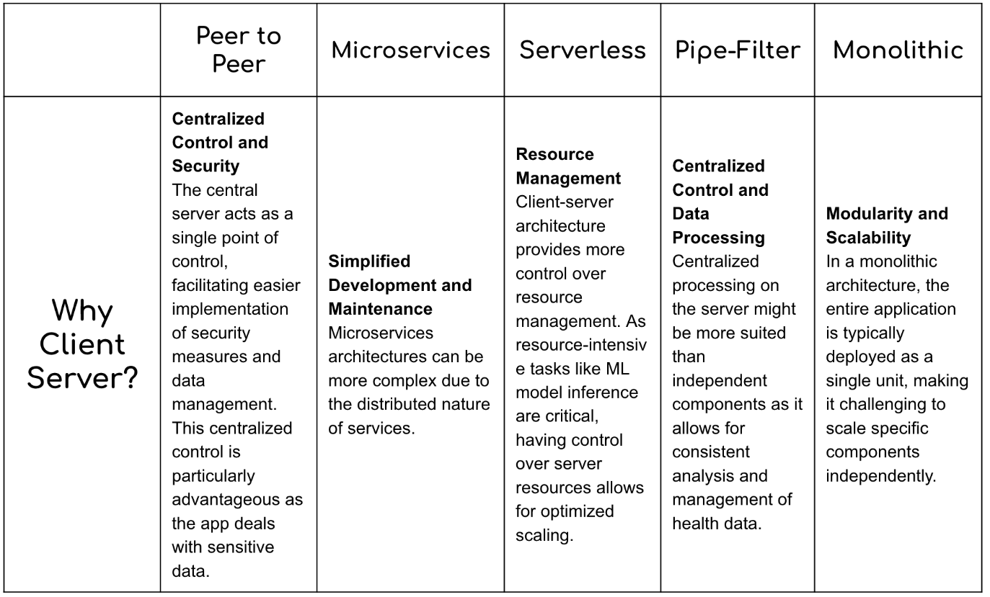
Software Architecture
Our initial idea was to use client-server architecture.

Slide 5
Modified Architecture
User’s information shall be stored locally and not on the central server. This implies the usage of serverless architecture for this purpose, while the rest of the application proceeds with client-server architecture, in a hybrid architecture model.
Reasons for this change:
Data privacy
Reduced latency
Offline access

Slide 6
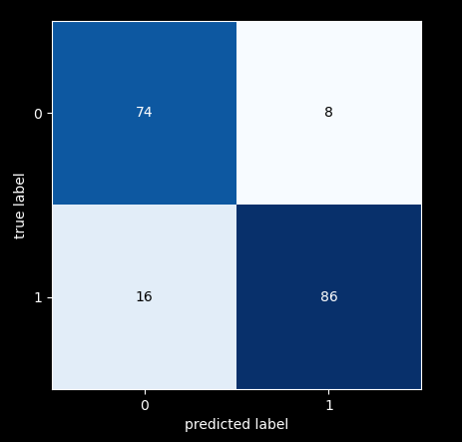
ML Model
Basic approach: The model was refined with the aim of increasing the recall score as far as possible because given that this app deals with health issues, we need to minimise the cases of false negatives.
The dataset can be viewed here.
Final Accuracy: 87%
Final ML Model
Confusion Matrix

Slide 7
Basic Functionality
The trained classifier is saved and accessed in Flask, using which we build an API which returns a dictionary of key-value pair, where the key is ‘output’ and the value is probability for developing cardiovascular disease by using the saved pre-trained classifier.
Profiles get saved on local storage to prevent the risk of theft/leakage of personal data. Storage is done on SQLite Database.
The table of data in SQLite can be viewed in a compact manner by tapping ‘saved profiles’ button.

Slide 8
UI Diagrams
Original UI diagrams that we had designed can be viewed here.
However, we did not get sufficient time to format the front end exactly as these images.

Slide 9
Implementation

Slide 10
Project Management
This document contains the following details:
Risk analysis and risk assessment matrix
Gantt charts (3 versions, the final one being updated to date)
Cost analysis (from the perspective of an organisation that desires to pursue this project)
Task dependencies and critical path

Slide 11
Software Versioning
Version 1.0.0: Basic ML model integration with the interface, giving prediction based on input data.
Version 1.1.0: Addition of features such as data visualization and generic health recommendations.
Version 1.1.1: Using unit testing to fix the bug in updation of details in saved profiles.
Version 2.0.0: Improved user interface based on feedback and enhanced frontend aesthetics.
Version 2.1.0: Addition of more graphs for better visualisation; limiting the input parameters to specific ranges for better accuracy.
Version 2.1.1: Fixed the bug of screen updating incorrectly after the details are edited.

Slide 12
Software Metrics
COCOMO: We would define our project in the category Semi-detached. So
Effort level:Medium, Time given: Medium
Cyclomatic Complexity: approximately 12-13 modules are being integrated, so moderate risk.
LOC: approximately 2300 LOC for development ; 400 LOC for ML model
Coupling: Low coupling, so good cohesion

Slide 13
Testing
Unit Testing:
We used this primarily for the app interface.
We were able to detect bugs such as incorrect updation of details post changes in input parameters, screen not being refreshed precisely, etc.
ML Model Testing:
Tested the ML model with absurd values to check the response of the model and determine important parameters.
Eg: We found that age is an important feature of the dataset as the predicted label was reducing tremendously on modifying just the age.

Slide 14
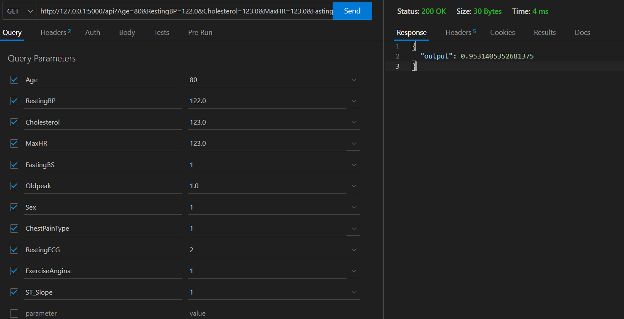
API Testing
We used Thunder Client extension of VS Code to check the performance of our locally created API.

Slide 15
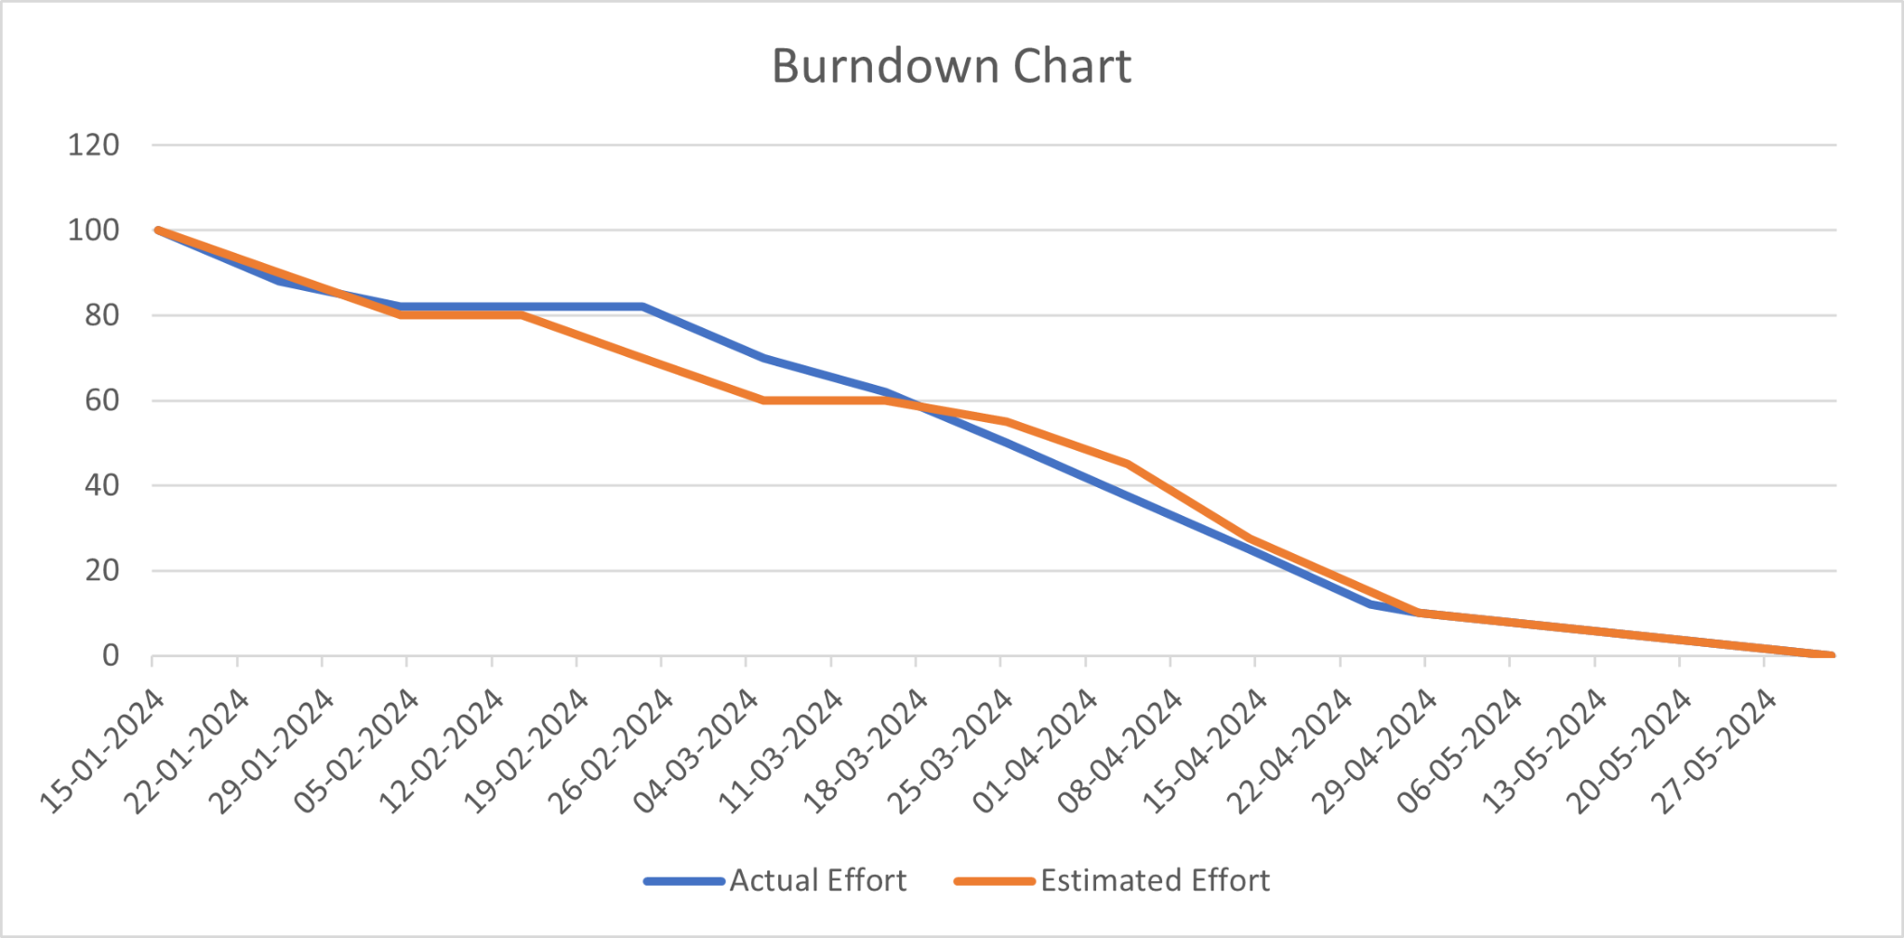
Progress Trajectory
Gantt Chart

Slide 16
Real Life Applications
Our project was designed with the hope to empower individuals to take proactive steps towards their heart health by identifying potential risks early.
Given that most users may not be familiar with the health parameters required to be given as inputs, this software can be used in medical setups which the users can access after taking blood tests.
Furthermore, the app can also be used by working medical professionals as a tool to assist them in making informed decisions and prioritizing patients for further evaluation or intervention.
Lastly, we intend to use additional data available in the medical world to train our model further at the end of regular timespans.

Slide 17
Challenges Faced | Solutions
ML Model Selection and Refinement | Explored a range of classifiers, and finally selected the one that offered a nice combination of accuracy and recall.
Data Privacy and Security | Implemented a hybrid SW architecture to ensure that the personal details of users are not susceptible to thefts/leakages.
Model and Database Integration | Created a local server which calls the API
Interpretability of Prediction Results | Provided graphical visualizations of the outputs generated to aid in the understanding of the users
Regulatory Obligations | Did not provide user-specific health recommendations as that would require legal permissions; instead provided generic guidelines for users suffering from such ailments.

Slide 18
Thank You!

